Slide 1
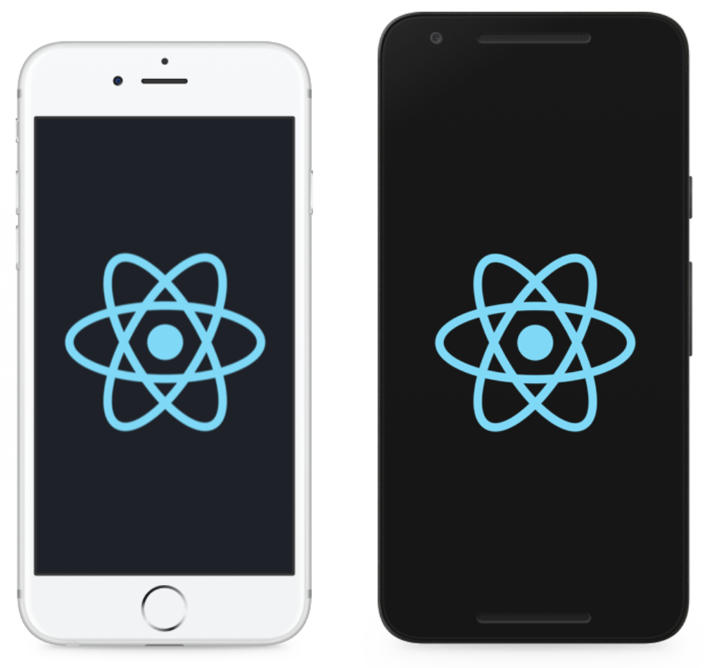
Introduction to React Native
Kavish Munjal

Slide 2
Notes:
Begin with React. Ask how many people are not familiar with React. It even a couple people are not, explain what it is.
React is a JavaScript library developed by Facebook. It is a way to make dynamic web applications. React will efficiently update and render just the right components when your data changes.

Slide 3
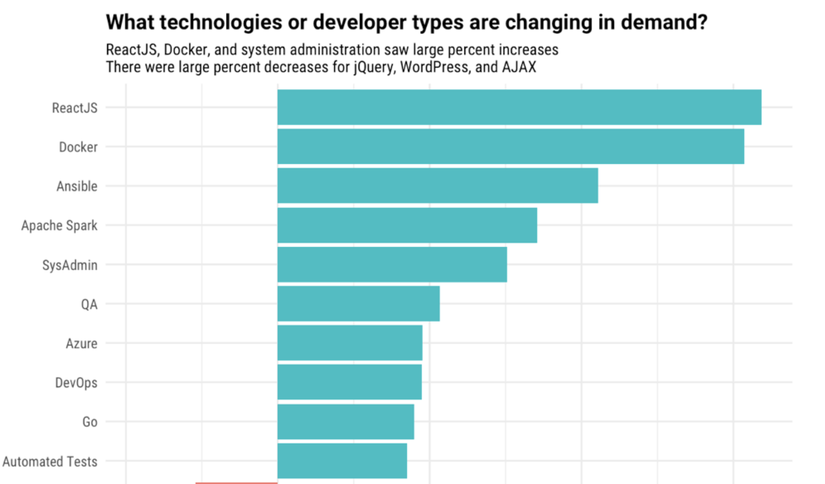
Notes:
React is gaining popularity quick.
According to stack overflow’s surveys, React rose from 12% in 2017 to 28% in 2018 as the most loved technology for professional developers

Slide 4
Components
Lifecycle
Props
State
Notes:
Some React concepts
Components: building blocks of an app. Anything from a button to the entire app is a React component
Each component manages it’s own state and has props that can be passed down to them by their parent component
React also provides lifecycle methods that allow the developer to control what happens when the component is mounted, updated, destroyed, etc

Slide 5
Traditional Mobile Development
Native iOS development: Swift (previously Objective-C); XCode IDE.
Native Android development: Java or Kotlin; Android Studio IDE.
Pros
Cons
Access to native APIs and UIs
Performance
Strongly typed and Compiled languages
Safer in the long run
One platform at a time
Time consuming
Learning curve
Notes:
Different platform features like camera, Touch ID, geo-position and others and access to 3rd-party libraries. However, RN also provides access to these tools
Strongly typed and compiled: Predictable logic and it becomes possible to localize mistakes and errors at compile time and deliver a better product. JS is weakly typed; recognition of errors and ability to fix them in early stages more complicated (Flow and Typescript can help with that)
Your app is not dependent on Facebook’s ability to keep RN updated and free of errors
Talk about my own experience with mobile development (Android)

Slide 6
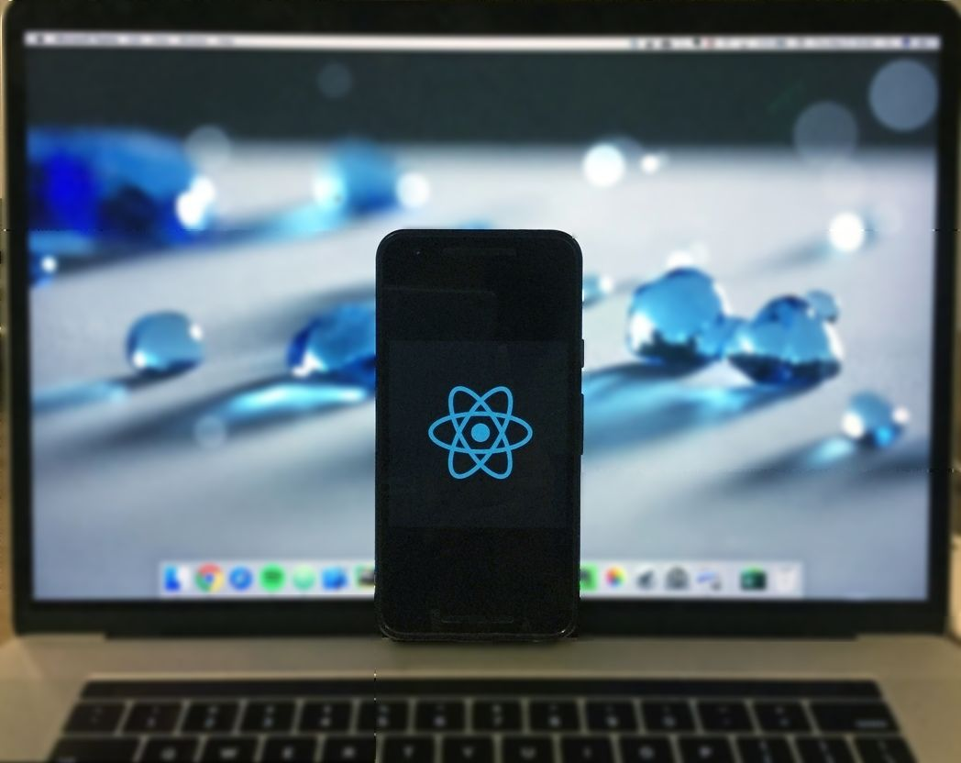

Notes:
So what is React Native? Like React, it is another JavaScript library but focused towards native mobile development. It uses native components instead of web components as building blocks. In Facebook's own words, a big reason to choose React is that it enables developers to spend more time focusing on their products and less time fighting with their framework. This is exactly what React Native does for mobile development.
Now, a developer would have to learn one thing, write one app and can re-use it across different platforms. Before I move on to details, I want to emphasise one thing. React Native does not build a web app that's disguised as a native mobile app; it builds a real native mobile app. The only difference is that the developer now only has to program in JavaScript and the library does the heavy lifting.

Slide 7


Slide 8
Facebook Ads Manager
Notes:
Facebook Ads Manager already had a web app for mobile, but they wanted to give the users a better experience by having a standalone native mobile app
But the problem was: none of them knew iOS. Thus the Ads manager became the first public React Native application. It took them less than a year. Within three months of the iOS version, the web version was released

Slide 9
Your First App
Create React Native App
React Native CLI
> npm install -g create-react-native-app
> create-react-native-app InitialApp
> cd InitialApp
> npm start
> npm install -g react-native-cli
> react-native init InitialApp
> cd InitialApp
> react-native run-ios
Notes:
Quick demo: Initial App
Show App.js file created

Slide 10
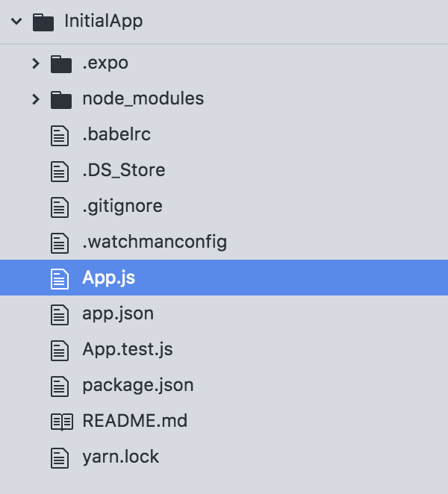
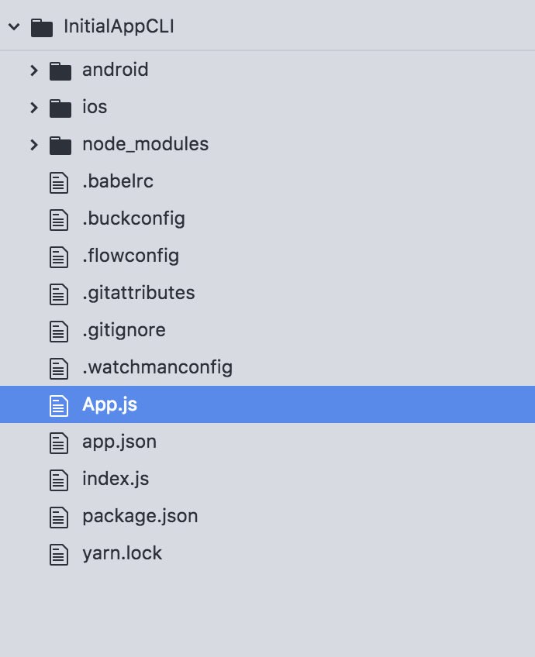
Create React Native App
React Native CLI

Slide 11
React Native
React Native development: JavaScript; no IDE necessary
Pros
Cons
One app
Native-like look and feel
Development Speed
Web concepts
Open Source
Leverage npm packages
No access to all native APIs
Complicated UI elements are harder
Long-term aspects
Notes:
With React Native there is no need to develop two separate applications. No need to learn two different languages and platforms.
For a web developer, going from web to mobile development can be tricky. React Native smooths the transition since it is a JavaScript framework.
No more compiling after every minor change and waiting for the app to reboot. React Native is moving fast. You always have the latest version. CodePush makes it faster to do deployments as well
The most used APIs are supported, but sometimes there is a need to access other APIs or functionality. Less third party libraries
Facebook could one day decide to stop updating the framework or the native platform could make changes that are hard to wrap around.
About 500,000 npm packages

Slide 12
Transformations
Notes:
In terms of implementation, View is an abstraction layer on top of the target platform's native equivalent, whether that's UIView, android.view, <div>, or something else.

Slide 13
Code Sharing
Same app for iOS and Android

Slide 14
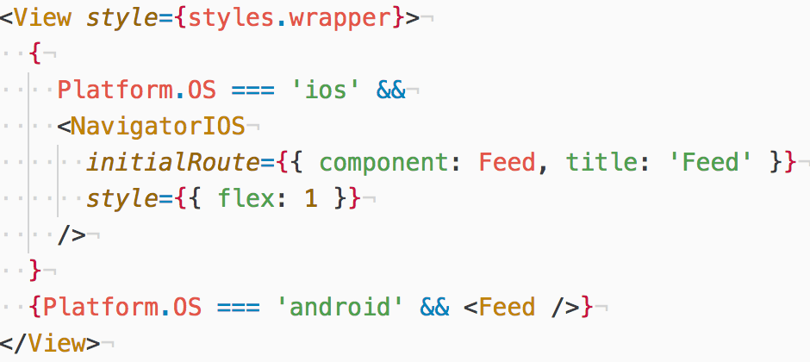
Code Sharing
Same app for iOS and Android
Platform Component

Slide 15
Code Sharing
Same app for iOS and Android
Platform Component
File Extensions

Slide 16
Components
View
Text
StyleSheet
FlexBox
Notes:
With React Native, you don't use a special language or syntax for defining styles. You just style your application using JavaScript. All of the core components accept a prop named style. The style names and values usually match how CSS works on the web

Slide 17
Flexbox
flexDirection: vertical (column) or horizontal (row) layout
justifyContent: primary axis of your layout
alignItems: secondary axis of your layout
Notes:
Components use the flexbox algorithm to specify the layout of their children. Flexbox is designed to provide a consistent layout on different screen sizes. For me, this was the most tricky part, since I don’t have any experience with Flexbox. But once you get the hang of it, it becomes quite powerful in specifying how the different components of an app should look.
Demo: Flexbox

Slide 18
Components
View
Text
StyleSheet
FlexBox
Touchables
TextInput
FlatList
NavigatorIOS
TabBar
Notes:
Demos: GithubClient
Animations are very important to create a great user experience. Stationary objects must overcome inertia as they start moving. Objects in motion have momentum and rarely come to a stop immediately. Animations allow you to convey physically believable motion in your interface

Slide 19
Data Management
State – simplest
Redux – most popular
Notes:
In this area, React Native can use the same techniques React uses. The best choices would depend on the complexity of the app itself. The simplest way is to store data in the state of a component and update it every time a user performs a relevant action on the component. A more complex way of dealing with data is to use Redux (most popular), GraphQL (to retrieve data from a server) or Realm (best for large amounts of data). GraphQL is a query language for easily fetching and updating remote data on any GraphQL-compliant server The Realm library uses a custom database, written from scratch in C to be compatible on both iOS and Android. It's suitable for apps with a tremendous amount of data

Slide 20
Redux
Store
Actions
Reducers
React Redux
Notes:
Redux is the most common choice of library for managing data in medium and large apps. Redux provides a store object which maintains the application state, and can notify your React components when state changes
An application will create a single Redux store to hold all data and state.
Actions should be plain objects containing a type field, e.g. {type: 'INCREMENT’}
You then define a function to handle actions, and update the store accordingly called a reducer

Slide 21
Data Management
State – simplest
Redux – most popular
Realm – large amounts of data
Notes:
In this area, React Native can use the same techniques React uses. The best choices would depend on the complexity of the app itself. The simplest way is to store data in the state of a component and update it every time a user performs a relevant action on the component. A more complex way of dealing with data is to use Redux (most popular), GraphQL (to retrieve data from a server) or Realm (best for large amounts of data). GraphQL is a query language for easily fetching and updating remote data on any GraphQL-compliant server The Realm library uses a custom database, written from scratch in C to be compatible on both iOS and Android. It's suitable for apps with a tremendous amount of data

Slide 22
Realm
Create relational models using schemas
Create, update, and delete records using transactions
Query tables and observe the results
Migrate the database
Encrypt stored data
Notes:
Realm is a cross-platform database for iOS and Android, made available as a React Native component
Realm is generally your best option if you want to use a real database, instead of storing all data in-memory with Redux
Realm also has an awesome desktop app for browsing the data stored on-device, which is a much better developer experience than using a SQLite database directly

Slide 23
Data Management
State – simplest
Redux – most popular
Realm – large amounts of data
GraphQL – retrieve data from a server
Notes:
In this area, React Native can use the same techniques React uses. The best choices would depend on the complexity of the app itself. The simplest way is to store data in the state of a component and update it every time a user performs a relevant action on the component. A more complex way of dealing with data is to use Redux (most popular), GraphQL (to retrieve data from a server) or Realm (best for large amounts of data). GraphQL is a query language for easily fetching and updating remote data on any GraphQL-compliant server The Realm library uses a custom database, written from scratch in C to be compatible on both iOS and Android. It's suitable for apps with a tremendous amount of data

Slide 24
Data Persistence
AsyncStorage
Redux persist
Notes:
Data persistence is often crucial to a great mobile experience. For example, you don’t want the user to log into your app every time they open it. A quick way to achieve data persistence is the built-in AsyncStorage API which makes it easy to save and retrieve key-value pairs.
Redux Persist is a library for automatically persisting the state of your Redux store to AsyncStorage on store changes, and rehydrating the store with this saved state when the app launches.
With Realm you get Persistence for free

Slide 25
React Native Web
Notes:
React Native for Web brings the platform-agnostic Components and APIs of React Native to the Web
High-quality user interface: native-like interactions, support for multiple input modes, built-in accessibility
Write once, render anywhere: interoperates with existing React DOM components and is compatible with the majority of the React Native API. You can develop new components for native and web without rewriting existing code
Who is using React Native for Web? Twitter, Flipkart, Playstation, Uber, The Times, React Native's documentation.

Slide 26
React Native Web
To put mobile apps on the web
As a web app framework

Slide 27
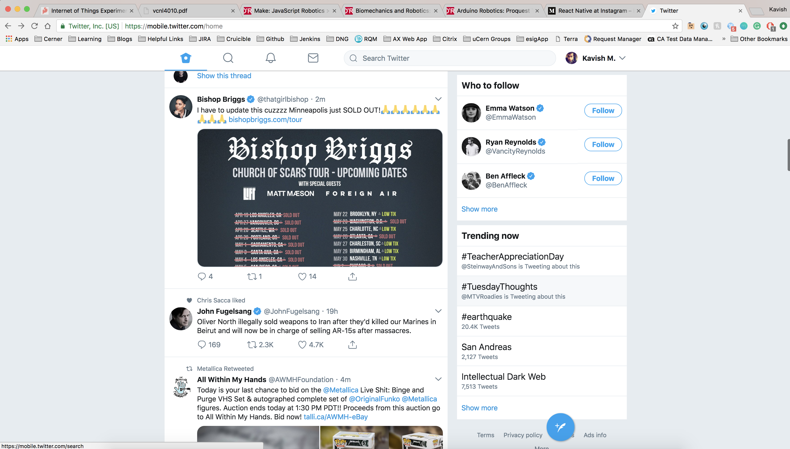
Notes:
In fact Instagram actually uses React Native. And Twitter mobile website, mobile.twitter.com even uses react native web, though I’m not sure to what extent

Slide 28
REACT

Slide 29
REACT NATIVE
REACT

Slide 30
REACT NATIVE WEB
REACT NATIVE
REACT

Slide 31
React Native Web
Built-in components from React Native (Storybook)
StyleSheets
Accessibility
accessible, accessibilityLabel, accessibilityLiveRegion, accessibilityRole
Notes:
React Native relies on JavaScript to define and resolve the styles of your application. React Native for Web implements the React Native style API in a way that avoids all the problems with CSS at scale. React Native for Web transforms React Native styles into React DOM styles. Any styles defined using StyleSheet.createwill ultimately be rendered using CSS class names.
On the Web, assistive technologies (e.g., VoiceOver, TalkBack screen readers) derive useful information about the structure, purpose, and interactivity of apps from their HTML elements, attributes, and ARIA in HTML. React Native for Web includes APIs designed to provide developers with support for making apps more accessible

Slide 32
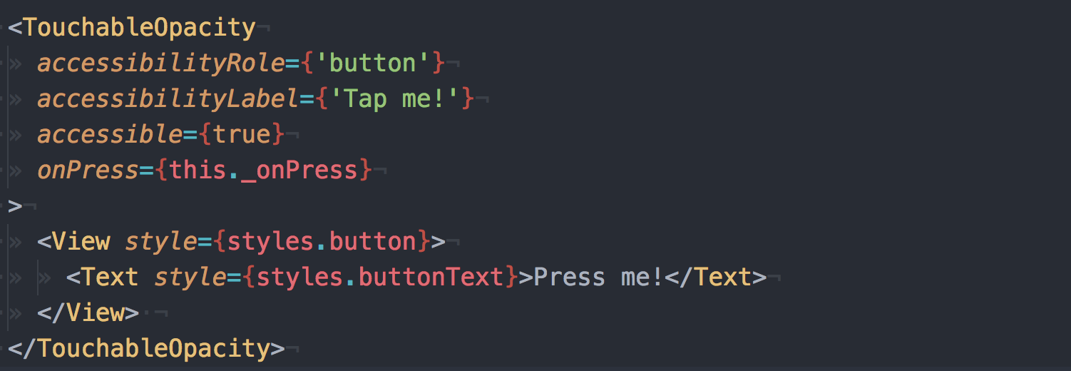
Accessibility
Notes:
Accessible Rich Internet Applications (ARIA) is a set of attributes that define ways to make Web content and Web applications (especially those developed with Ajax, JavaScript and more recent web technologies like Bootstrap) more accessible to people with disabilities.
When a view is marked as accessible, it is a good practice to set an accessibilityLabel on the view, so that people who use screen readers know what element they have selected. On web, accessibilityLabel is implemented using aria-label.

Slide 33
React Native Web
Built-in components
StyleSheets
Accessibility
I18n
Direct Element Access
createElement
Notes:
To support right-to-left languages, application layout can be automatically flipped from LTR to RTL React Native provides several methods to directly access the underlying host node. This can be useful when you need to make changes directly to a component without using state/props to trigger a re-render of the entire subtree, or when you want to focus a view or measure its on-screen dimensions. Instance methods: blur(), focus(), measure()
React Native for Web exports a web-specific module called createElement, which can be used to wrap React DOM components. This allows you to use React Native's accessibility and style optimizations.

Slide 34
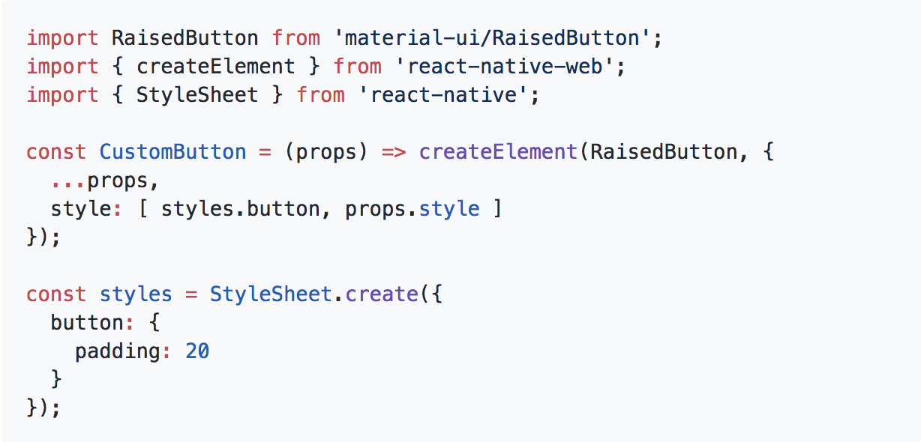
createElement example

Slide 35
Finishing Thought
Try it out

Slide 36
Resources
Getting started: https://facebook.github.io/react-native/docs/getting-started.html
A good reference: http://www.reactnativeexpress.com/ (also has the Flexbox demo I used)
Pluralsight course: https://app.pluralsight.com/library/courses/build-ios-apps-react-native/table-of-contents (it’s a bit outdated, but a nice way to get started)
Cool component library: https://github.com/react-native-training/react-native-elements
React Native Web: https://github.com/necolas/react-native-web
Source code for the GitHub app: https://github.com/kavisherlock/GithubClient-ReactNative
Summary of my talk: https://kavishrm.wordpress.com/2018/05/06/a-web-developer-going-native/
https://github.com/jondot/awesome-react-native

